Slide 1
BASICS OF R PROGRAMMING
Instructions for Hands-on Session

Slide 2
Swirl Package
The swirl R package makes it fun and easy to learn R programming and data science.
If you are new to R, have no fear.
we’ll walk you through each of the steps required to begin using swirl today!

Slide 3
Swirl Package
Open RStudio and type the following into the console:
> install.packages("swirl")
Note that the > symbol at the beginning of the line is R's prompt for you type something into the console.
The part you type begins after ”>”.

Slide 4
Swirl Package
Then you will call the function that starts the magic! Type the following, pressing Enter after each line:
> library("swirl")
> swirl()

Slide 5
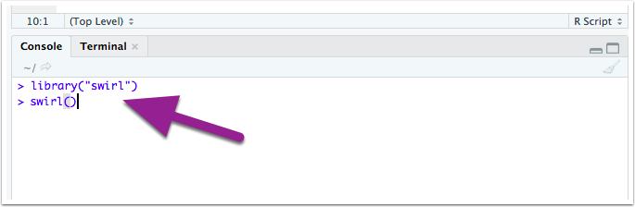
Swirl Package

Slide 6
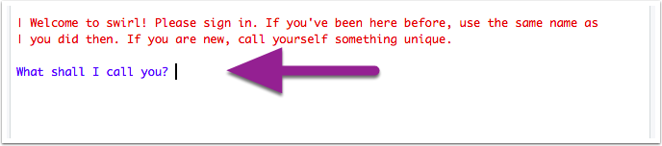
Swirl Package

Slide 7
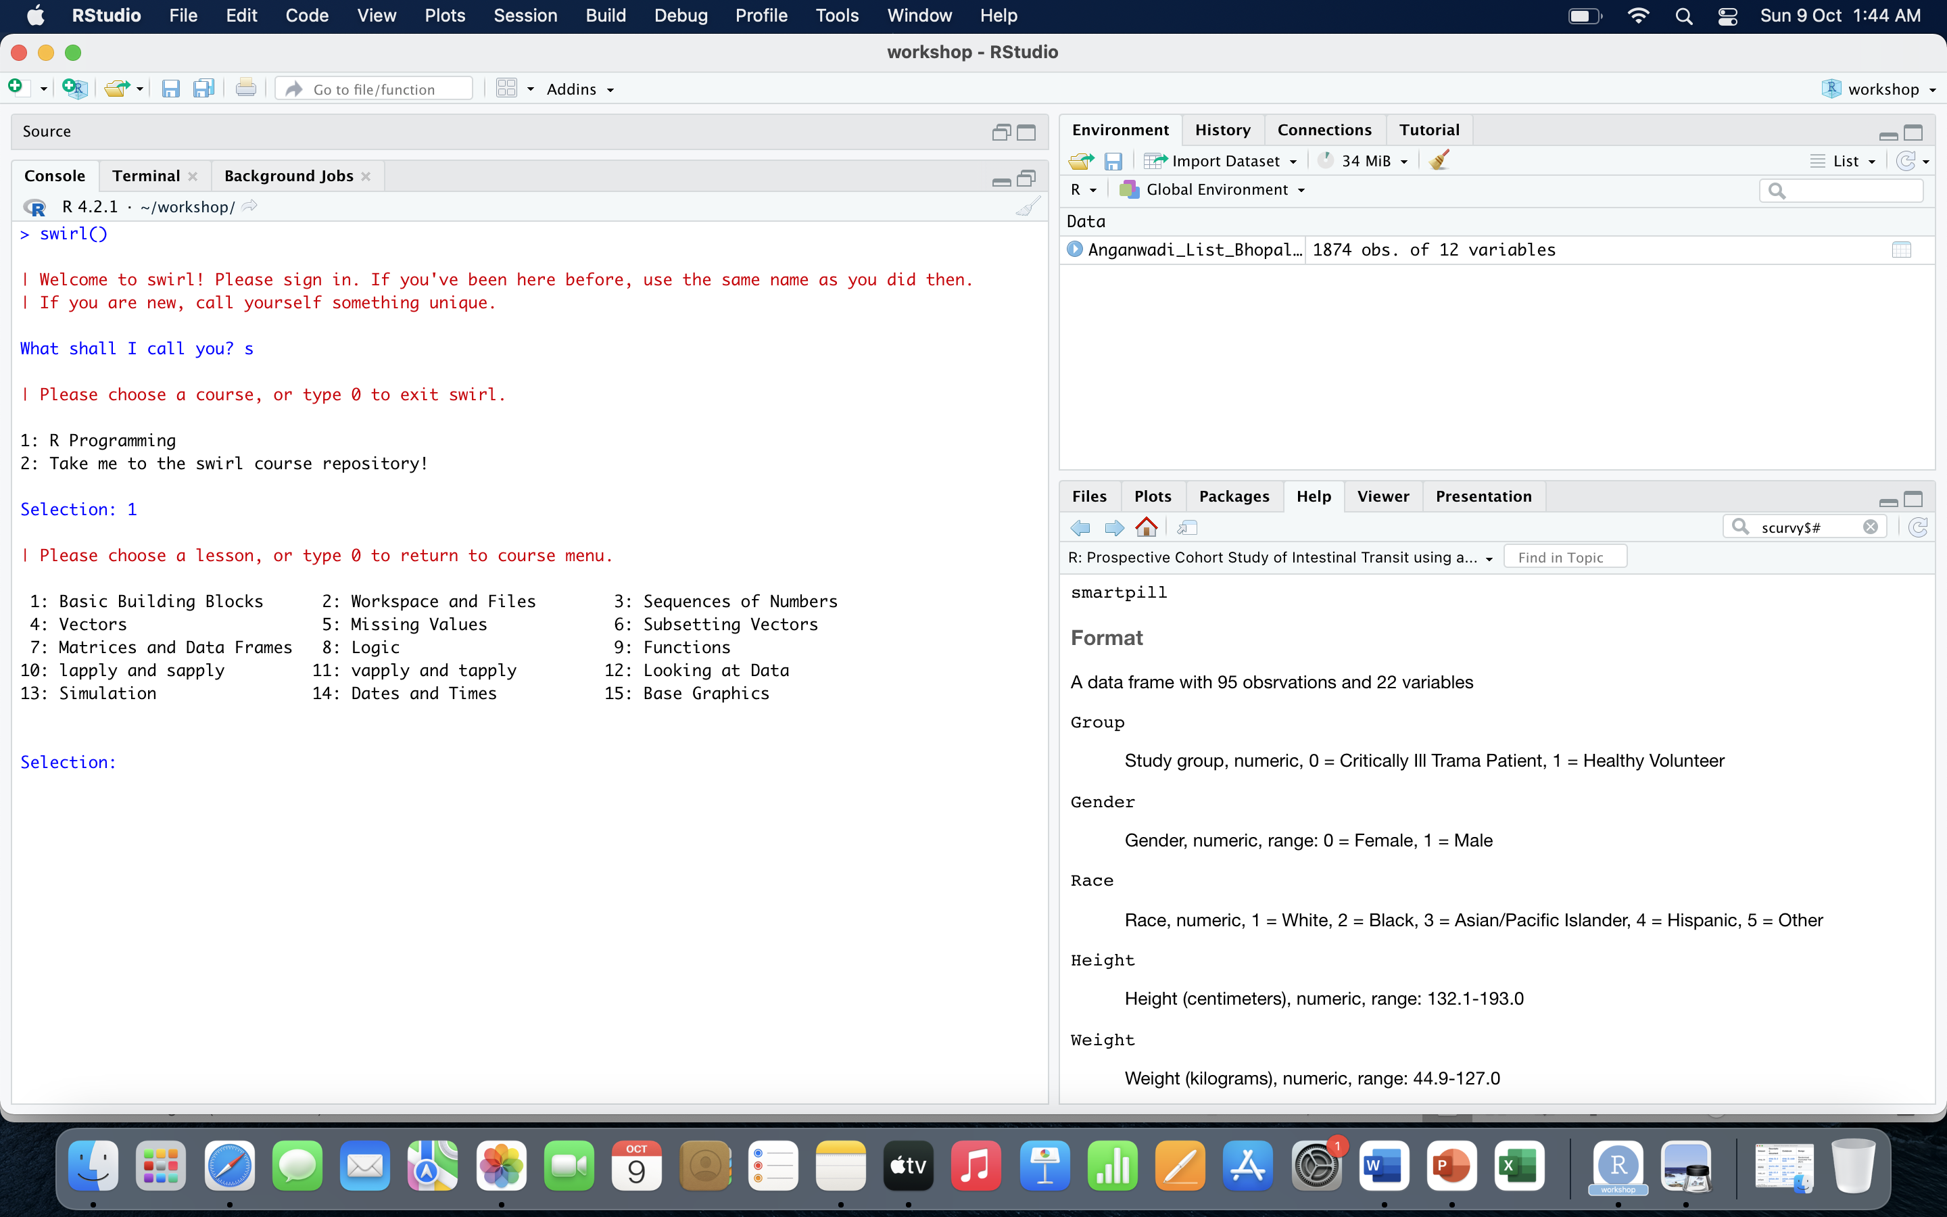
Swirl Package

Slide 8
Swirl Package
Basic building blocks(1)
Sequences of numbers(3)
Vectors(4)
Subsetting vectors(6)
Matrices and data frames(7)
Logic(8)

Slide 9
R Operators
R supports majorly four kinds of binary operators between a set of operands. In this article, we will see various types of operators in R Programming language and their usage.

Slide 10
Arithmetic Operators
Addition x + y
Subtraction x - y
Multiplication x * y
Division x / y

Slide 11
Logical Operators
Logical operations simulate element-wise decision operations, based on the specified operator between the operands,
Which are then evaluated to either a True or False boolean value.

Slide 12
Relational Operators
They carry out comparison operations between the corresponding elements of the operands. Returns a boolean TRUE value if the first operand satisfies the relation compared to the second.
A TRUE value is always considered to be greater than the FALSE.

Slide 13
Assignment Operators
Assignment operators are used to assigning values to various data objects in R. The objects may be integers, vectors, or functions. These values are then stored by the assigned variable names.
Left Assignment <-

Slide 14
Primers
R is easiest to use when you know how the R language works. You’ll learn about:
functions and their arguments
objects
R’s basic data types
R’s basic data structures including vectors and lists
R’s package system

Slide 15
Primers
https://rstudio.cloud/learn/primers
A key feature of R is functions. Functions are “self contained” modules of code that accomplish a specific task. Functions usually take in some sort of data structure (value, vector, data frame etc.), process it, and return a result.

Slide 16
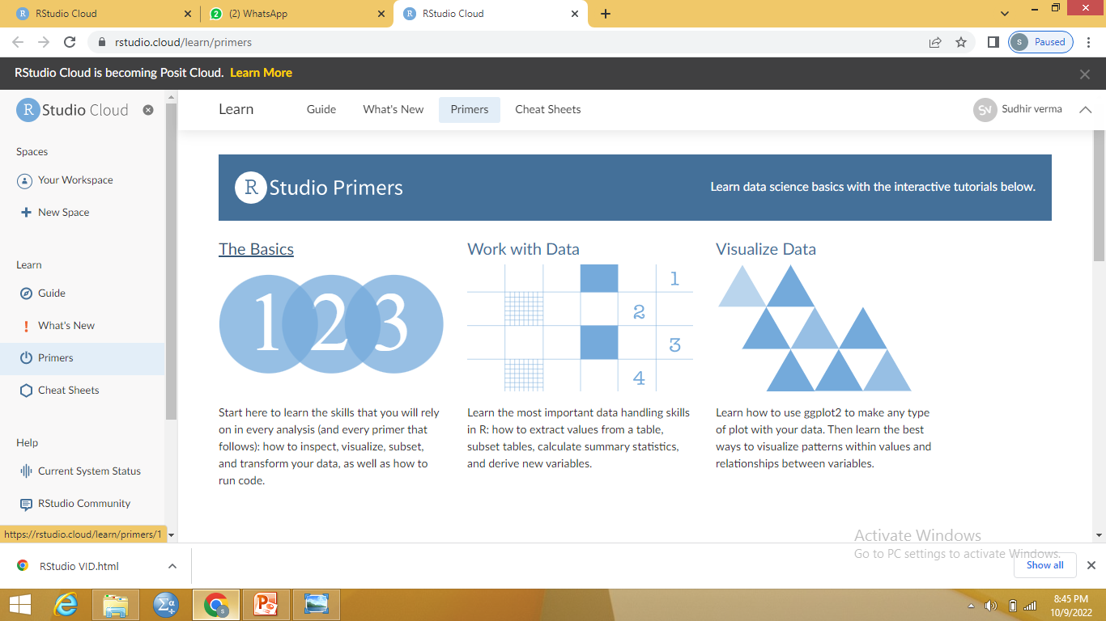
Primers

Slide 17
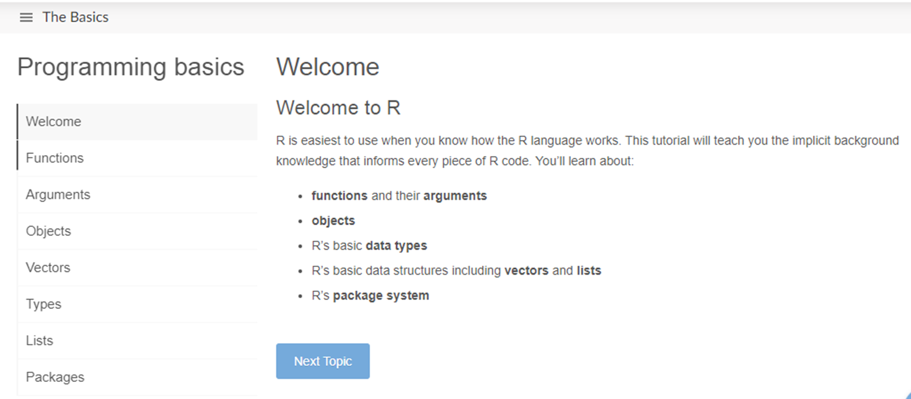
Primers

Slide 18
Functions
Functions are “self contained” modules of code that accomplish a specific task.
R has a large number of in-built functions and the user can create their own functions.

Slide 19
An R function is created by using the keyword function. The basic syntax of an R function definition is as follows −
function_name <- function(arg_1, arg_2, ...)
{ Function body }

Slide 20
Function Name − This is the actual name of the function. It is stored in R environment as an object with this name.
Arguments − An argument is a placeholder. When a function is invoked, you pass a value to the argument. Arguments are optional; that is, a function may contain no arguments. Also arguments can have default values.

Slide 21
Function Body − The function body contains a collection of statements that defines what the function does.
Return Value − The return value of a function is the last expression in the function body to be evaluated.
Simple examples of in-built functions are seq(), mean(), max(), sum(x) and paste(...) etc

Slide 22
Objects
An object is a data structure having some attributes and methods which act on its attributes.
For example, objects are assigned a value using <-

Slide 23
Objects
R consists of a number of data objects to perform various functions. There are 6 types of objects in R Programming. They include vector, list, matrix, array, factor, and data frame.

Slide 24
Arguments
The parameters provided to a function to perform operations in a programming language.
In R programming, we can use as many arguments as we want and are separated by a comma.

Slide 25
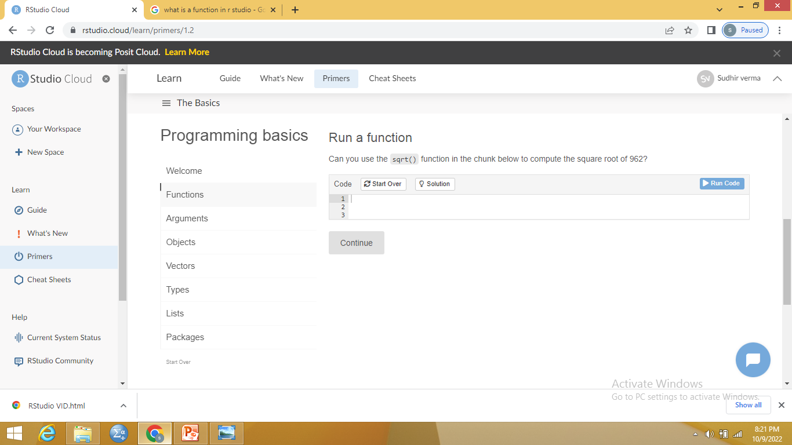

Slide 26
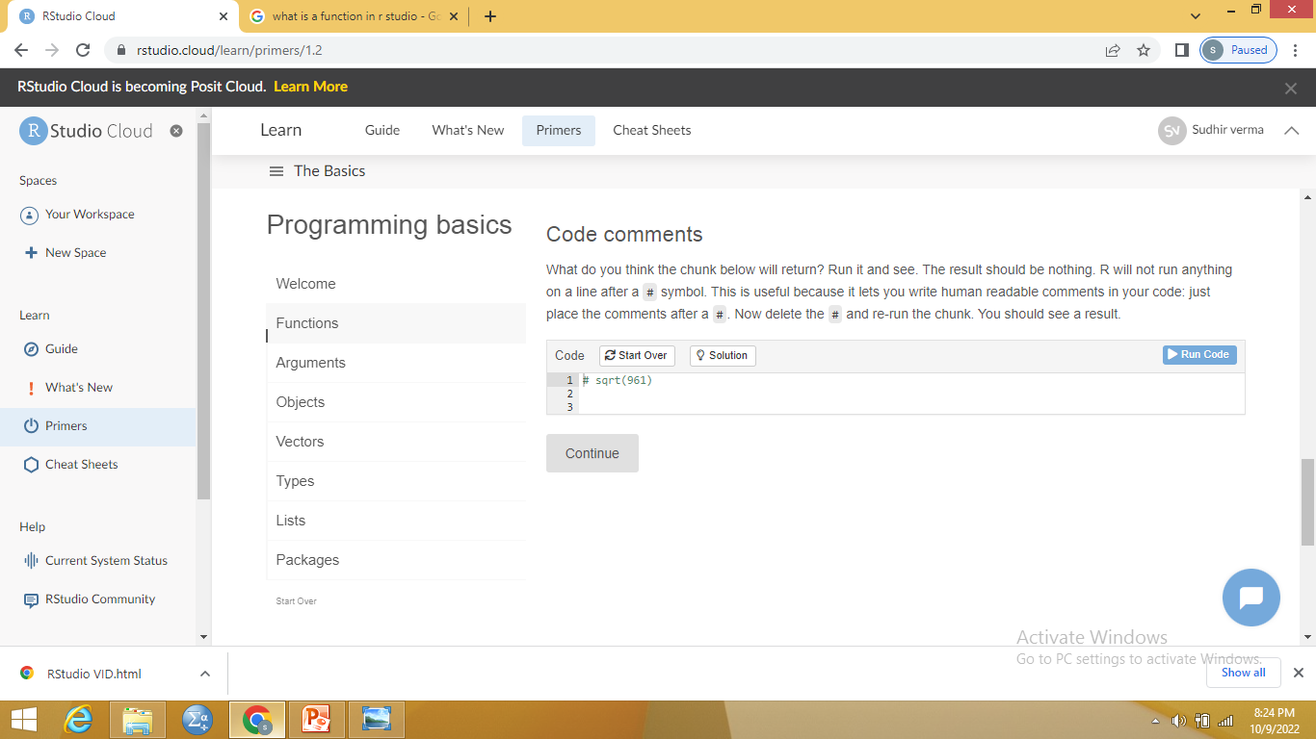

Slide 27
The simplest and most common data structure in R is the vector
Atomic vectors and lists

Slide 28
Atomic vectors
Numeric
Logical
Character
Integer
complex

Slide 29
LOGICAL VECTORS
True, False, NA (not available)
>,<=,==FOR Exact equality, and != for inequality

Slide 30
working directory
The working directory is just a file path on your computer that sets the default location of any files you read into R, or save out of R
You can only have one working directory active at any given time. The active working directory is called your current working directory.

Slide 31
Script
A script is simply a text file containing a set of commands and comments.
The script can be saved and used later to re-execute the saved commands.
The script can also be edited so you can execute a modified version of the commands.

Slide 32
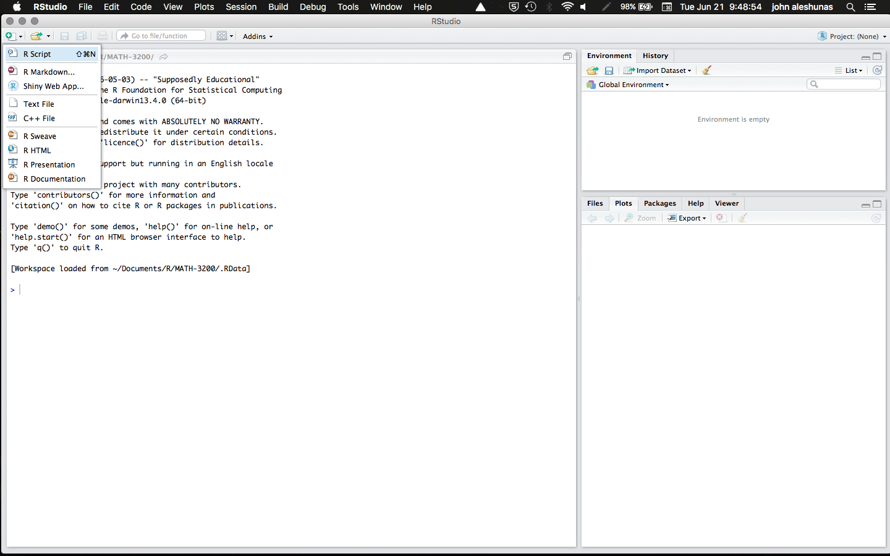

Slide 33


